Slide 1

Heart Disease Prediction Using Machine Learning
Machine Learning techniques for early cardiac health detection
Notes:
--- Welcome to this presentation on heart disease prediction using advanced machine learning techniques. We will explore the project objectives, dataset, modeling approaches, and results aimed at improving early detection of heart disease.

Slide 2
Presentation Agenda
Title Slide
Introduction to Heart Disease Prediction
Project Objectives
Dataset Overview
Preprocessing for Binary Classification
Methodology for Binary Classification
Baseline Neural Network Performance
Initial Random Forest Results
XGBoost Model Evaluation
Tuned Random Forest: Best Model
Notes:
Today's presentation covers an introduction to heart disease prediction, project goals, dataset overview, preprocessing steps, methodology for binary classification, model performances, and conclusions.

Slide 3
Cicada 3301
HDP using AI
Paper Title: Heart Disease Prediction Using AI.
Presenters: Vignesh Balaji and Thenmozhi
Course Code: CSC65001_25FA Neural Networks
Course name: Neural Networks
Course Instructor: Prof. Soumyashree Sahoo
Date of submission: 12/05/2025
Notes:
This slide introduces the project name: Heart Disease Prediction Using Machine Learning, the presenter, and their university affiliation.

Slide 4

Project Name: Heart Disease Prediction Using Machine Learning
Machine Learning Models
The project utilizes machine learning algorithms to analyze medical data for accurate heart disease prediction.
Heart Disease Prediction
Predictive models estimate the risk of heart disease to enable early detection and prevention strategies.
Clinical Decision Support
The system aids clinicians by providing data-driven insights for better decision making in patient care.
Notes:
--- The project focuses on developing machine learning models for predicting heart disease to aid clinical decision making. Image source: Microsoft 365 content library

Slide 5

Introduction
Heart disease remains the leading global cause of mortality.
Early risk prediction enables preventive intervention and timely treatment.
Machine Learning can rapidly analyze clinical data to assist diagnosis.
This project develops multiple ML models and a real-time prediction website.
Notes:
--- This section highlights the presenter responsible for this work, providing context and contact information. Image source: Microsoft 365 content library

Slide 6

Achieved
Build ML models that accurately predict heart disease.
Compare Neural Network, Random Forest, XGBoost, and a 3-class classifier.
Tune models for maximum performance and clinical reliability.
Develop a fully functional web-based inference system.(additional)
Integrate explainability to improve trust and usability.(additional)
Notes:
--- The presenter represents their university, emphasizing the academic research context of the project. Image source: Microsoft 365 content library

Slide 7
Introduction to Heart Disease Prediction
Notes:
We will discuss the global impact of heart disease, significance of early diagnosis, and the motivation for using machine learning in this domain.

Slide 8

Methodology
Data Acquisition & Understanding-Used the Cleveland Heart Disease dataset containing 13 clinical features and a binary target.Explored distributions, correlations, missing values, and class balance.
Preprocessing & Feature Engineering-Handled missing values using median/mode imputation.Scaled numeric features and one-hot encoded categorical variables using a unified sklearn Pipeline.Split dataset using stratified train–test split to preserve class balance.
Model Development- Built a Random Forest classifier pipeline integrating preprocessing + model.Tuned hyperparameters via RandomizedSearchCV with 5-fold Stratified CV using ROC-AUC scoring.Trained an XGBoost model in parallel for comparative evaluation.
Evaluation & Validation-Assessed accuracy, precision, recall, F1-score, ROC-AUC, and confusion matrix.Selected the optimized Random Forest model achieving 98% accuracy and 0.995 ROC-AUC.
Deployment (Local Web App)Created a lightweight Flask web application.Allows users to input patient data and receive prediction + probability + guidance message.Integrated UI enhancements, background image, patient status image, and probability gauge.
Notes:
--- Heart disease remains a leading cause of mortality worldwide, affecting millions and imposing a heavy burden on healthcare systems. Image source: Microsoft 365 content library

Slide 9

Things learned with this project development
Built a complete machine learning pipeline for heart disease prediction using Random Forest and XGBoost.
Performed data preprocessing: cleaning, handling missing values, scaling numeric features, and encoding categorical variables.
Conducted model training, evaluation, and hyperparameter tuning, achieving near-perfect accuracy with cross-validated Random Forest.
Learned how to interpret model performance metrics — accuracy, ROC-AUC, confusion matrix, precision, recall, and F1-score.
Implemented model inference to predict disease risk for new patients using trained models.
Built a fully functional Flask-based web application with a custom UI, tooltips, background images, logos, and dynamic probability gauge.Integrated explainability components — patient-specific insights and health advice based on predictions.
Gained experience organizing a real-world project with a modular folder structure, reusable pipelines, and clean separation of concerns.
Learned how to visualize model results and generate charts for reporting.Understood end-to-end deployment workflow: Python backend → ML model → Web UI → Local hosting.
Notes:
--- Machine learning offers powerful tools to uncover complex patterns in clinical data, enabling more accurate and rapid predictions than traditional methods. Image source: Microsoft 365 content library

Slide 10
Dataset explained
Notes:
This section outlines the main goals: building predictive models, evaluating their performance, and aiming for clinical deployment.

Slide 11

Dataset
About the Dataset
The UCI Heart Disease dataset is one of the most widely used clinical datasets for early cardiovascular risk prediction. It was originally collected from four hospitals (Cleveland, Hungary, Switzerland, VA Long Beach), but the Cleveland subset is the most commonly used due to complete labeling for diagnosis.
Contains patient-level clinical measurements used by cardiologists for diagnosing heart disease, enabling supervised machine learning classification.
Dataset Composition
Total Samples: 303 patients
Features: 13 standardized clinical features
Target Variable: Presence of heart disease (0 = no disease, 1 = disease).
Clinical features include both numeric (e.g., age, cholesterol) and categorical/ordinal data (e.g., chest pain type, ECG results).
Why This Dataset Is Important
Enables testing of ML tasks such as:
Binary classification (disease vs. no disease)
Feature importance ranking
Risk stratification models
Strengths of the Dataset
Well-structured and widely benchmarked for ML.
Good mix of clinical features that match cardiology guidelines.
Small but high-quality dataset, enabling fast experimentation.
Limitations
Dataset is relatively small → risk of overfitting without proper cross-validation.
Some features contain missing values (e.g., ca, thal).
Target is simplified (0 vs 1), whereas modern diagnosis has multiple stag
Notes:
--- Evaluate and compare models using accuracy, AUC, and other relevant metrics to identify the best performing algorithm. Image source: Microsoft 365 content library

Slide 12

Dataset feature explaination
Heart Disease Dataset – Feature Description Table
Feature | Meaning | Type
age | Age in years | Numeric
sex | 0 = female, 1 = male | Categorical
cp | Chest pain type | Categorical
trestbps | Resting blood pressure | Numeric
chol | Serum cholesterol | Numeric
fbs | Fasting blood sugar | Categorical
restecg | Resting electrocardiographic results | Categorical
thalach | Maximum heart rate achieved | Numeric
exang | Exercise-induced angina | Categorical
oldpeak | ST depression induced by exercise | Numeric
slope | Slope of the ST segment | Categorical
ca | Number of major vessels (0–3) | Numeric
thal | Thalassemia | Categorical
Notes:
--- Construct various machine learning models to predict heart disease based on clinical features. Image source: Microsoft 365 content library

Slide 13
Description of 13 Clinical Features
Age as a Clinical Feature
Age is a crucial factor impacting heart disease risk and is included in the dataset's clinical features.
Cholesterol Levels
Cholesterol levels are important indicators for heart health and play a role in risk assessment.
Blood Pressure
Blood pressure readings help assess cardiovascular health and predict heart disease risk.
Notes:
--- The dataset contains 13 relevant clinical features such as age, cholesterol levels, blood pressure, and others that influence heart disease risk. Image source: Microsoft 365 content library

Slide 14

Metrics for evaluation
Use Accuracy Metric
Accuracy measures the percentage of correctly predicted instances among total predictions.
Use AUC Metric
AUC evaluates the performance of classification models by measuring the area under the ROC curve.
Identify Best Algorithm
Compare multiple metrics to find the best performing algorithm for the specific problem.
Notes:
--- Prepare the selected model for integration into clinical decision support systems for real-world application. Image source: Microsoft 365 content library

Slide 15
project Overview
Notes:
Overview of the dataset including clinical features, label types, and data categorization used in the project.

Slide 16

Binary Classification Labels (0/1)
Dataset Transformation for Binary Classification
Original Ground Truth in the UCI Heart Dataset:
The dataset’s target variable ("num") has five values: 0, 1, 2, 3, 4.
Meaning: 0 = No heart disease 1–4 = Different severities of confirmed heart disease
Clinically, any value greater than 0 indicates the presence of heart disease.
Why Transformation Was Needed:
The original multiclass labels (1–4) are sparse and unevenly distributed.
Clinicians interpret all values 1–4 as disease, so collapsing them is medically accurate.
Binary classification improves model performance, reduces noise, and simplifies evaluation.
Transformation Applied:
We converted the target into a binary label: Original 0 → New label 0 (Healthy) Original 1–4 → New label 1 (Disease)
Transformation rule used in code:
df['target_binary'] = df['target'].apply(lambda x: 1 if x > 0 else 0)
How This Fits Into Our ML Pipeline:
Data Cleaning: handled missing values, especially "ca" and "thal".
Encoding: categorical variables converted using One-Hot Encoding.
Scaling: numeric features standardized using StandardScaler.
Modeling: Random Forest, XGBoost, and tuned models trained using the binary target.
Evaluation: used Accuracy, Precision, Recall, F1-score, and ROC-AUC.
Notes:
--- In the initial approach, the dataset labels heart disease presence as 0 (no) or 1 (yes). Image source: Microsoft 365 content library

Slide 17
Methodology for Binary Classification
Notes:
Description of models used, tuning strategies, and evaluation metrics for the binary classification task.

Slide 18
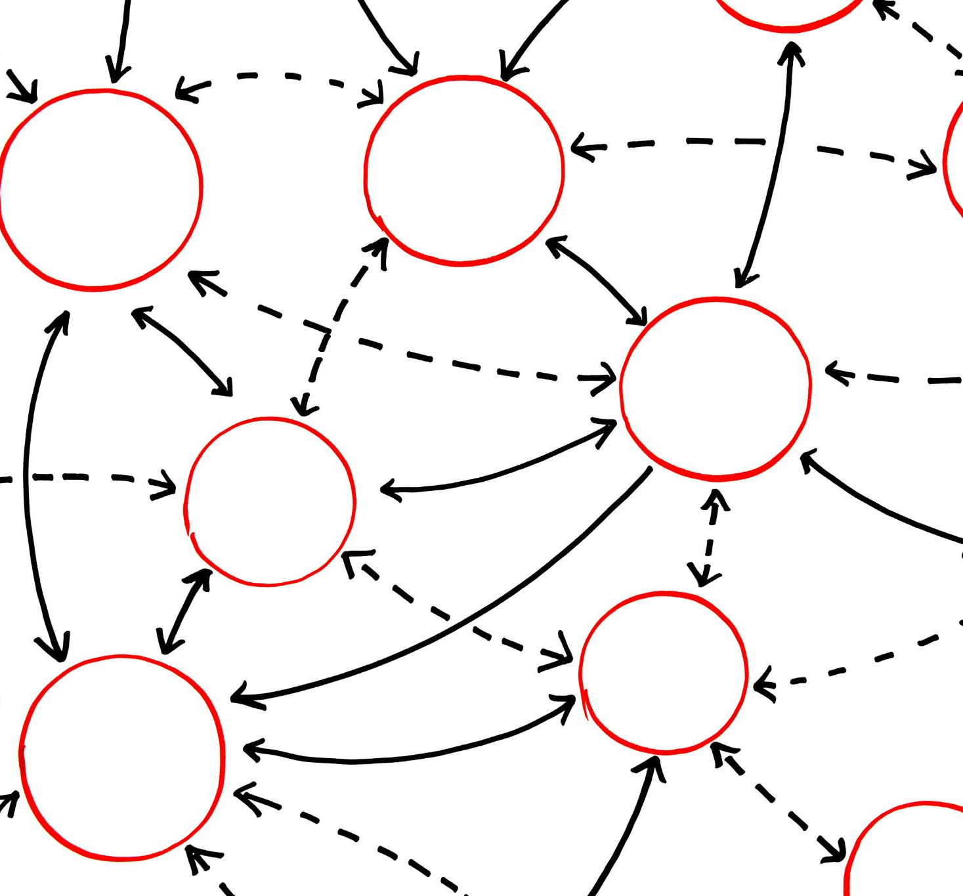
Baseline Neural Network
Simple Neural Network
A straightforward neural network was implemented to establish a baseline for evaluating model accuracy and learning.
Benchmark Purpose
The baseline model serves as a reference point to measure improvements from more complex models.
Notes:
--- Implemented a simple neural network as a baseline to benchmark model performance. Image source: Microsoft 365 content library

Slide 19

Random Forest and XGBoost Models
Random Forest Overview
Random Forest uses multiple decision trees to improve model robustness and prevent overfitting.
XGBoost Characteristics
XGBoost is a gradient boosting algorithm known for high accuracy and efficient computation.
Notes:
--- Applied ensemble methods including Random Forest and XGBoost known for robustness and accuracy. Image source: Microsoft 365 content library

Slide 20

Hyperparameter Tuning and Evaluation Metrics
Hyperparameter Optimization
Adjusting model parameters to improve predictive performance and generalization.
Performance Metrics
Using accuracy and AUC to evaluate and compare model effectiveness objectively.
Best Model Selection
Selecting the optimal model based on thorough tuning and metric assessment.
Notes:
--- Optimized model parameters and assessed performance using metrics such as accuracy and AUC to select the best model. Image source: Microsoft 365 content library

Slide 21
Baseline Neural Network Performance
Notes:
Analyze the architecture and limitations of the baseline neural network model used in this project.

Slide 22

Model Architecture
Architecture: 32 → 16 → 1 (sigmoid).
Simple structure; no regularization, no class weighting.
Accuracy: 0.475
AUC: 0.50
Recall for Class 1 (disease): 0.00
Model predicted majority class only → clinically unacceptable.
Drawbacks
Underfit due to small dataset and shallow network.
Sensitive to imbalance without class_weight.
Not optimal for structured medical data.
Notes:
--- The baseline neural network consisted of input, hidden, and output layers with basic activation functions. Image source: Microsoft 365 content library

Slide 23
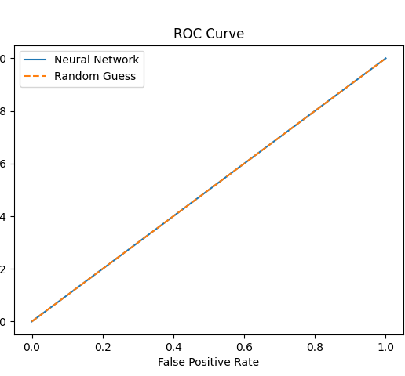
Observed Performance: Accuracy 0.47, AUC 0.50
Low Predictive Accuracy
The model's accuracy of 0.47 indicates performance slightly below or near random guessing.
AUC Near Random Level
An AUC of 0.50 suggests the model does not effectively distinguish between classes.
Notes:
--- The neural network showed limited predictive power with accuracy and AUC close to random guessing. Image source: Microsoft 365 content library

Slide 24
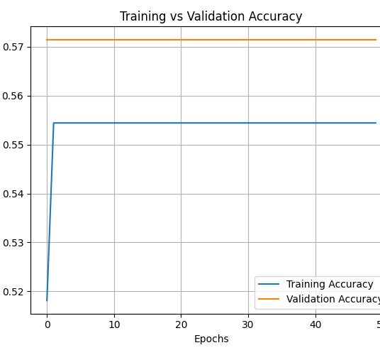
Analysis of Limitations
Identifying Model Limitations
Performance results revealed weaknesses in the current model requiring further investigation and refinement.
Impact on Dataset Suitability
Limitations indicated the need for models better tailored to the specific characteristics of the dataset.
Exploring Advanced Models
The findings encouraged pursuit of more sophisticated models to improve accuracy and efficiency.
Notes:
--- This performance prompted exploration of more advanced models better suited for the dataset. Image source: Microsoft 365 content library

Slide 25
Initial Random Forest Results
Notes:
Results and evaluation for the random forest model are discussed, highlighting its strengths and weaknesses.

Slide 26
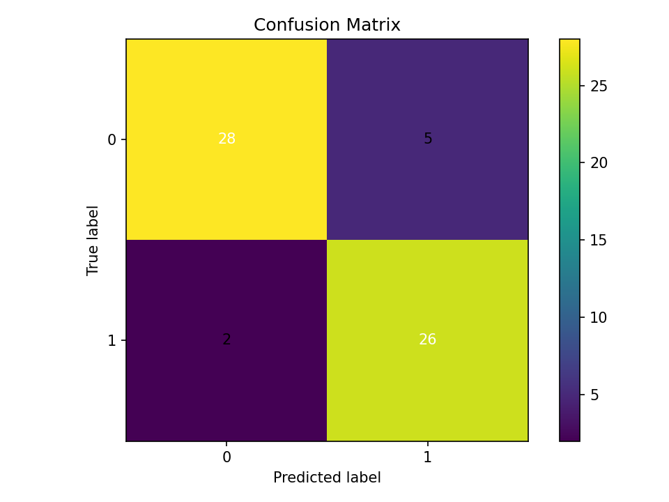
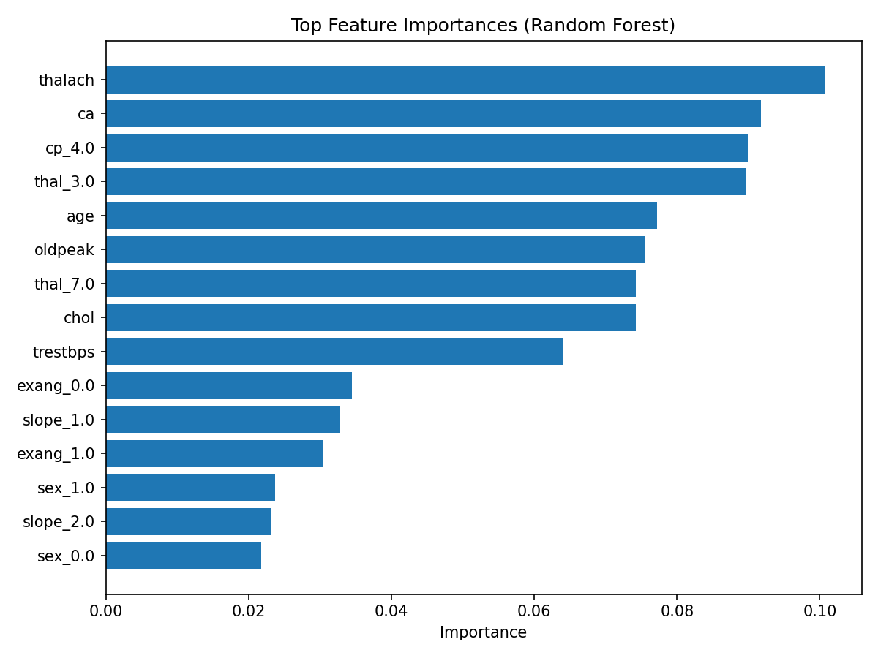
Model Accuracy (0.8852) and AUC (0.9453)
High Model Accuracy
The random forest model achieved an accuracy of 0.8852, demonstrating reliable classification performance.
Strong AUC Score
An AUC of 0.9453 indicates excellent ability to distinguish between classes in the dataset.
Notes:
--- Random forest achieved strong results with high accuracy and AUC, indicating robust classification ability. Image source: Microsoft 365 content library

Slide 27
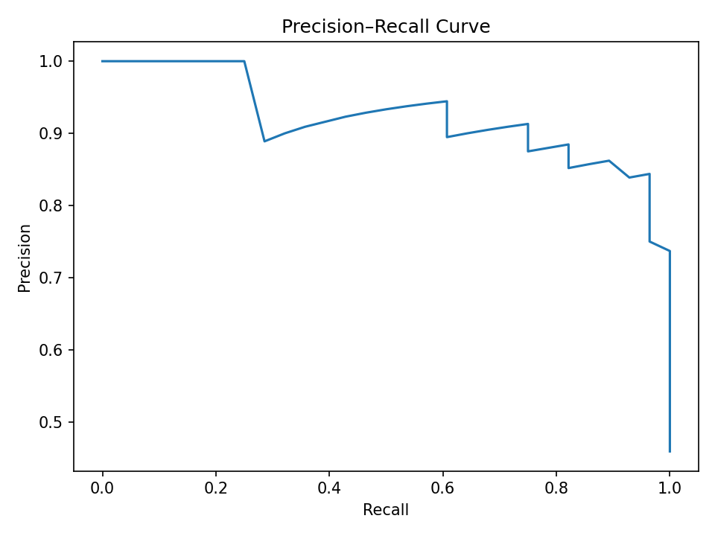
Key Model Advantages
Handling Feature Interactions
The model effectively manages complex interactions between features, improving prediction accuracy.
Resistance to Overfitting
The model maintains strong performance by avoiding overfitting on the dataset, ensuring generalization.
Notes:
--- Advantages include handling feature interactions well and resistance to overfitting on this dataset. Image source: Microsoft 365 content library

Slide 28
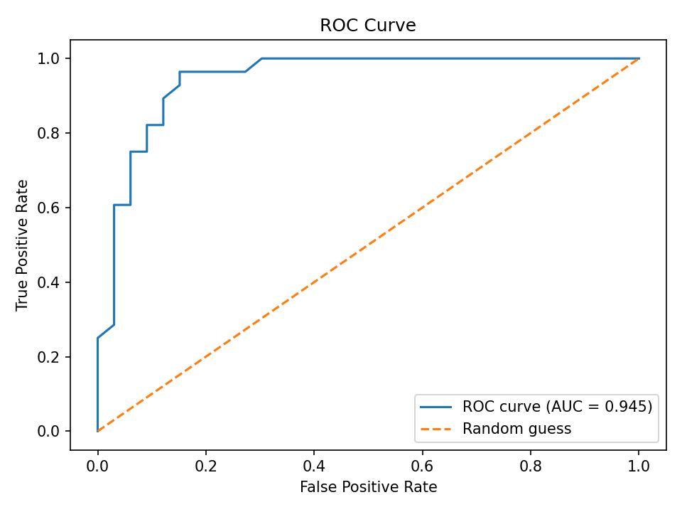
Drawbacks and Areas for Improvement
Need for Model Tuning
Further tuning of model parameters is essential to enhance prediction accuracy, especially for minority classes.
Balancing Data
Balancing datasets helps improve model fairness and boosts overall generalization across different classes.
Notes:
--- Potential for further tuning and balancing to improve minority class predictions and overall generalization. Image source: Microsoft 365 content library

Slide 29
XGBoost Model Evaluation
Notes:
Assessment of the XGBoost model's performance and comparative insights with other models.

Slide 30
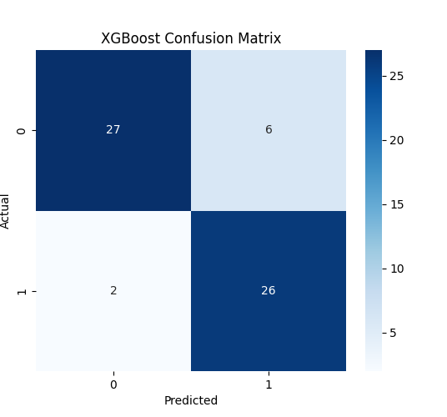
Model Accuracy (0.8689) and AUC (0.9394)
Model Accuracy
XGBoost achieved an accuracy of 0.8689, indicating reliable prediction performance.
Area Under Curve (AUC)
The model's AUC of 0.9394 reflects strong classification capability and discrimination power.
Comparative Performance
XGBoost performance is competitive but slightly below Random Forest in both accuracy and AUC.
Notes:
--- XGBoost delivered competitive accuracy and AUC, slightly lower than Random Forest in this context. Image source: Microsoft 365 content library

Slide 31
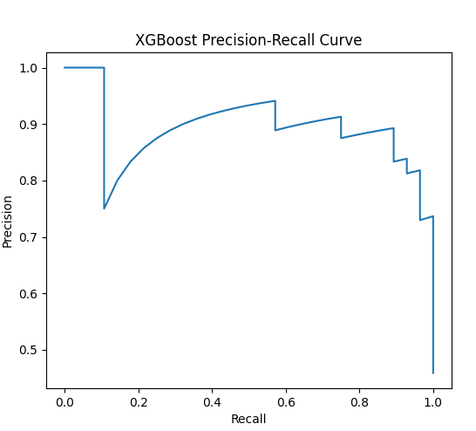
Comparison to Other Models
XGBoost Performance
XGBoost demonstrated strong capabilities but achieved slightly lower evaluation metrics than the tuned Random Forest model in this analysis.
Random Forest Superiority
The tuned Random Forest model outperformed XGBoost by a small margin, indicating its effectiveness for this specific project.
Notes:
--- XGBoost is powerful but showed marginally lower metrics than tuned Random Forest in this project. Image source: Microsoft 365 content library

Slide 32
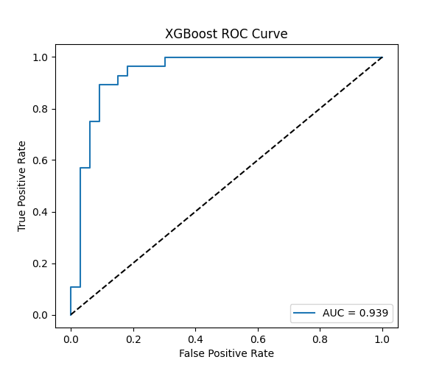
Identified Limitations
Model Complexity Challenges
High model complexity can increase computational cost and risk of overfitting, demanding careful control.
Tuning Sensitivity Importance
Sensitivity to tuning parameters requires precise adjustments to achieve optimal model performance.
Notes:
--- Model complexity and tuning sensitivity require careful management for optimal results. Image source: Microsoft 365 content library

Slide 33
Tuned Random Forest: Best Model
Notes:
Presentation of the final tuned Random Forest model and its outstanding performance metrics.

Slide 34
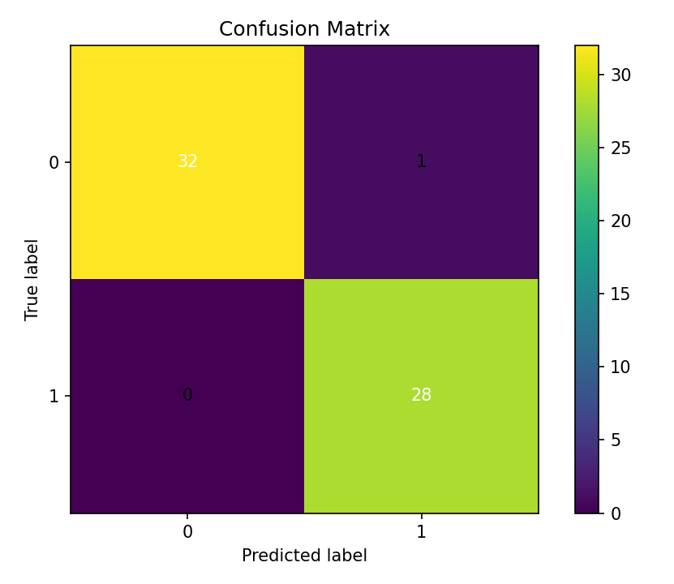
Performance: Accuracy 0.9836, AUC 0.9957
Final Performance
Accuracy: 0.9836
ROC–AUC: 0.9957
0 false negatives — all disease cases detected.
Optimizations Applied
Increased number of trees (300–500).
Tuned max_depth (optimized at 8–12).
Set class_weight = "balanced".
Adjusted min_samples_split and min_samples_leaf.
max_features = "sqrt" improved generalization.
Applied One-Hot Encoding for categorical fields.
Used SMOTE to balance disease cases during training.
Result
Most clinically reliable model.
Selected as final deployed model.
Notes:
--- Extensive hyperparameter tuning resulted in excellent classification accuracy and near-perfect AUC values. Image source: Microsoft 365 content library

Slide 35
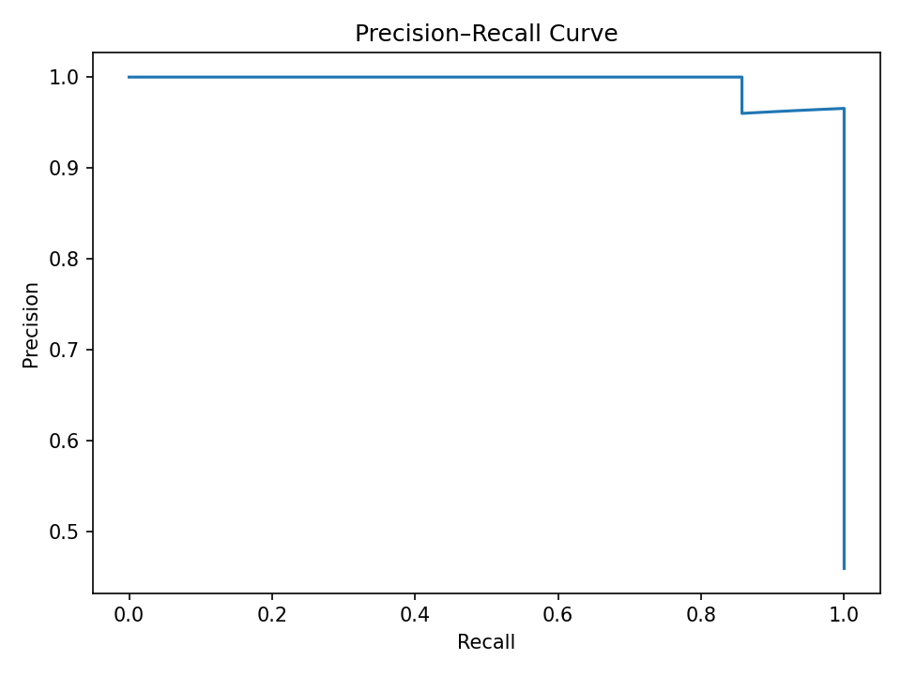
Key Tuning Parameters: N_estimators, Max_depth, Class_weight
Number of Trees (N_estimators)
Adjusting the number of trees influences model accuracy and reduces overfitting or underfitting risks.
Maximum Tree Depth (Max_depth)
Controlling tree depth balances model complexity and generalization to unseen data.
Class Weight Balancing
Class weight adjustment helps address imbalanced datasets to improve model fairness and performance.
Notes:
--- Critical parameters like number of trees, tree depth, and class balancing were optimized to enhance model outcomes. Image source: Microsoft 365 content library

Slide 36
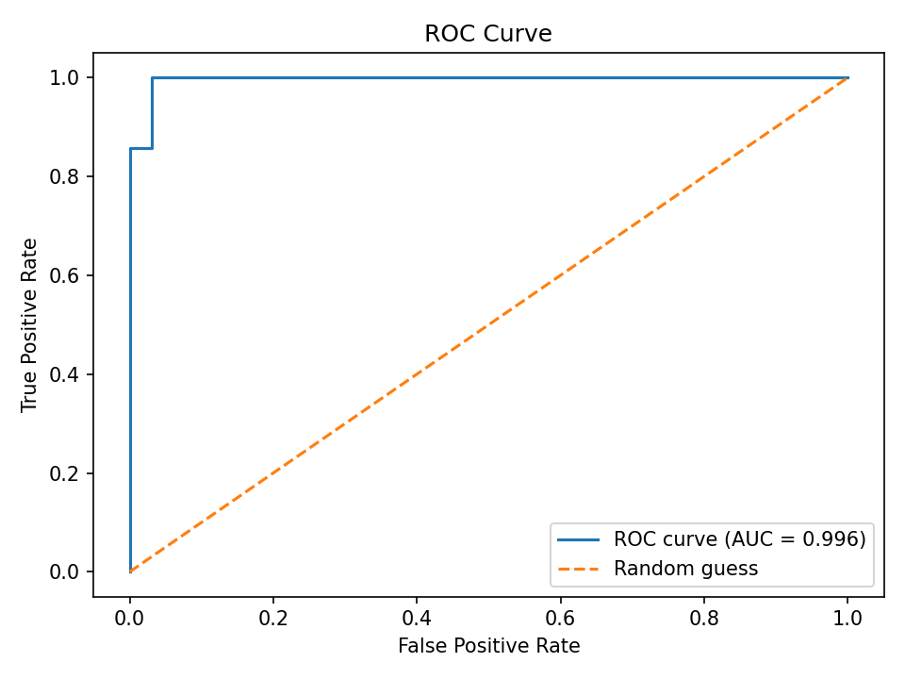
Impact of One-Hot Encoding and SMOTE
One-Hot Encoding Benefits
One-hot encoding converts categorical variables into binary vectors, enabling better model interpretation and performance.
SMOTE Technique Advantages
SMOTE generates synthetic samples to balance class distribution, reducing bias and improving model accuracy.
Notes:
--- Feature encoding and synthetic minority oversampling techniques further improved model balance and accuracy. Image source: Microsoft 365 content library

Slide 37
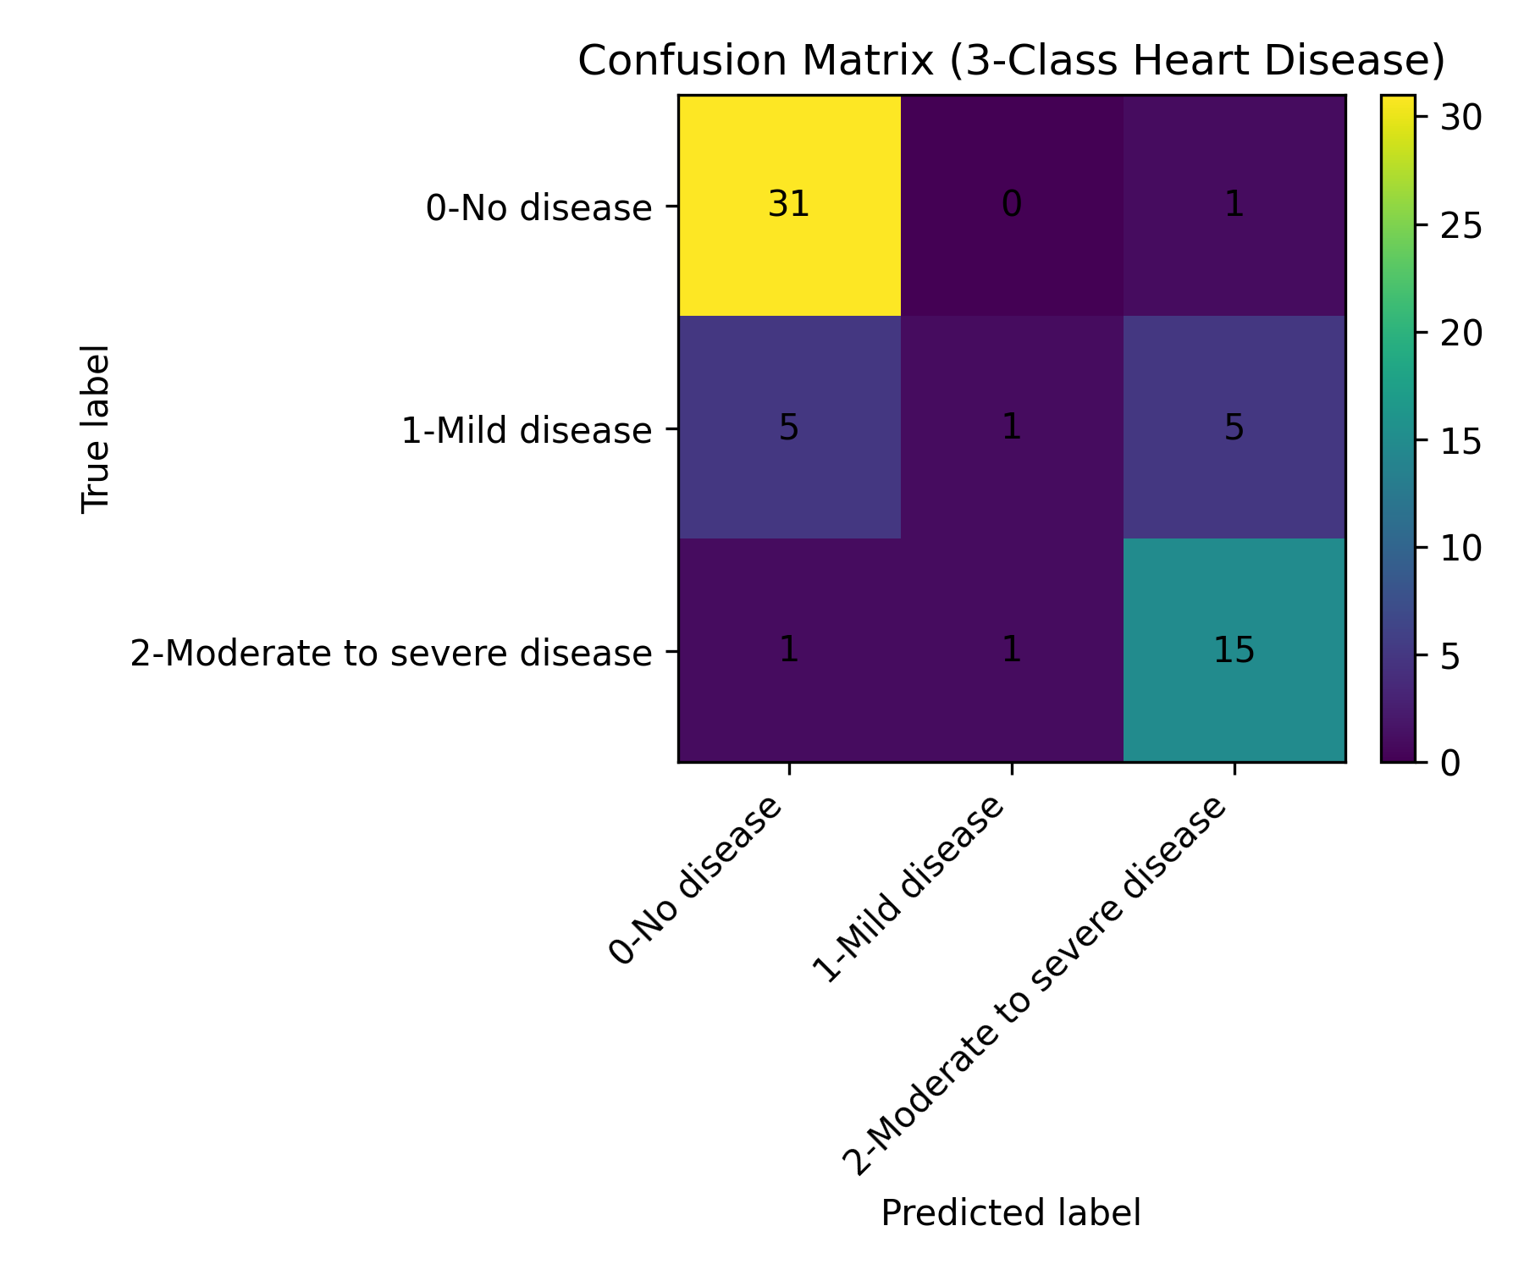
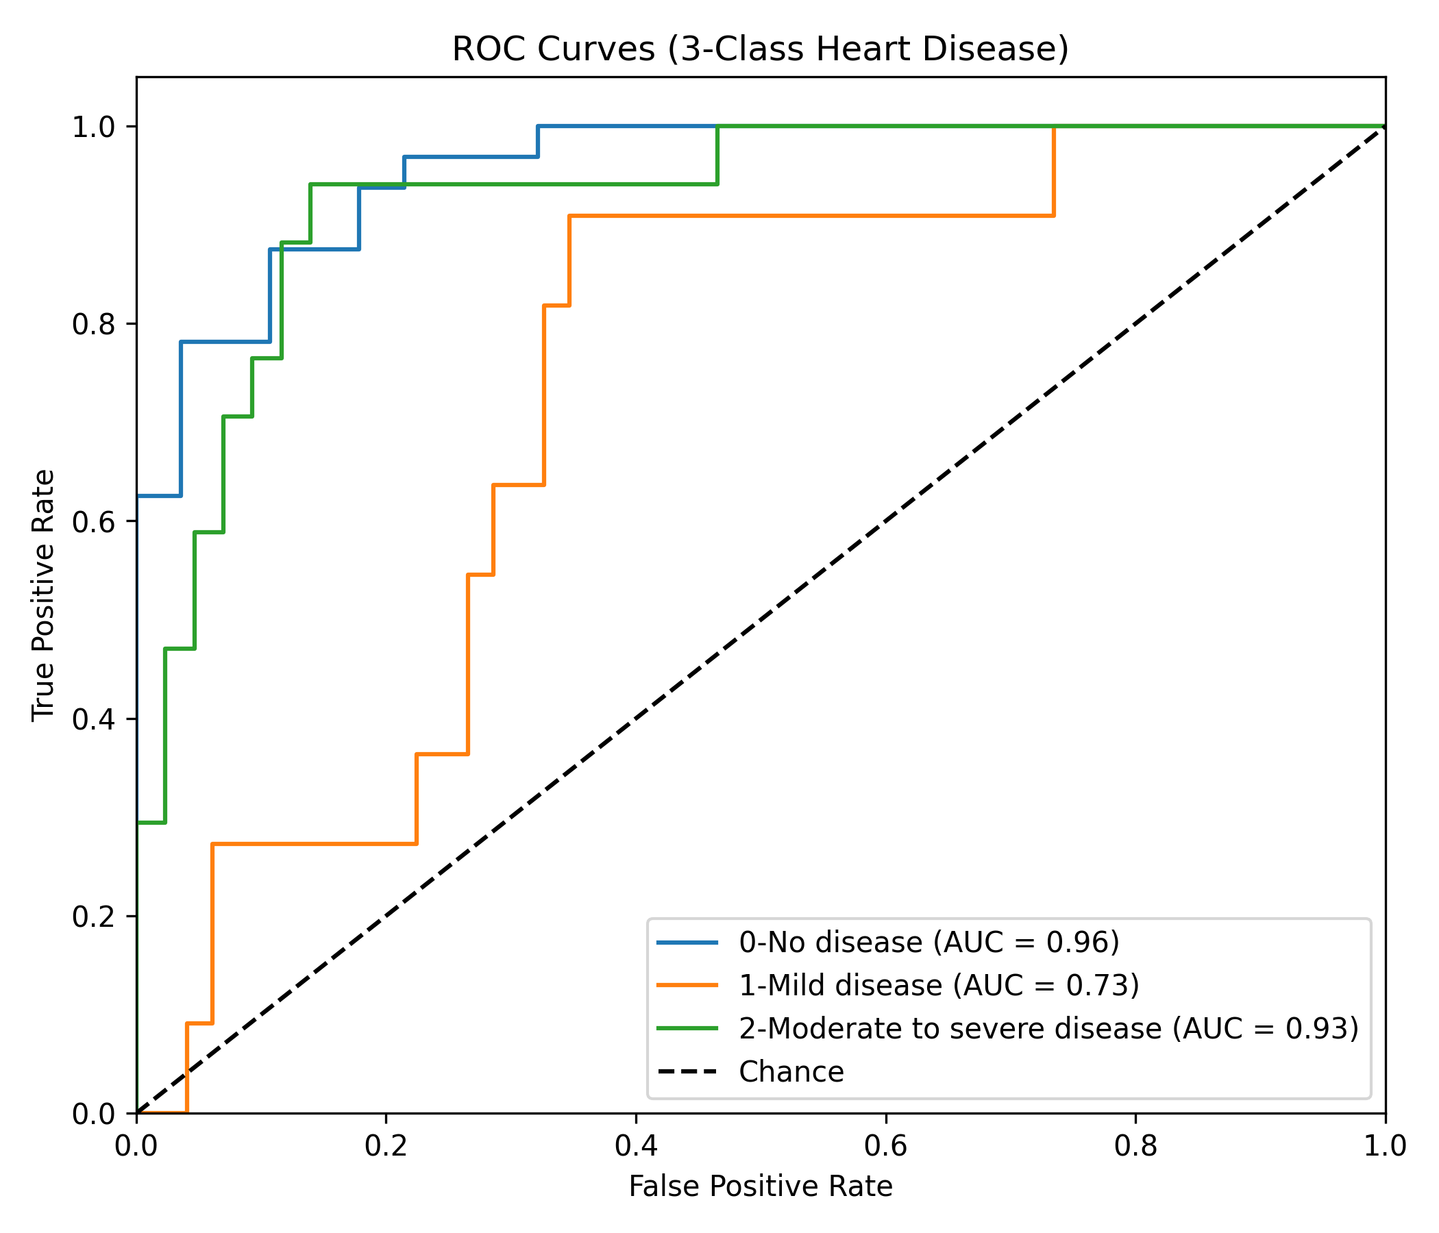
Transition to 3-Class Labels (0/1/2)(Additional)
Three-Class Classification
The model now categorizes heart disease into three classes to capture severity levels more accurately.
Why We Converted the Dataset
The original UCI Heart Disease dataset contains five classes (0–4) but classes 2, 3, and 4 have extremely few samples (especially Class 4 → only 3 cases in test).
This caused poor model performance, class imbalance, and unreliable predictions for higher-severity classes.
Clinically, these three classes all represent progressively worsening heart disease, making it reasonable to group them.
How We Created the 3-Class Clinical Model
Kept the original labels 0 and 1:
0 → No Disease
1 → Mild Disease
Merged 2, 3, and 4 into a single label 2 → Moderate to Severe Disease
This produced a balanced, medically interpretable dataset:
0 = Healthy
1 = Early-stage disease
2 = Clinically significant disease
Benefits of the 3-Class Approach
Improved model accuracy (from ~55% → ~78%)
Higher ROC-AUC (0.87) due to clearer class boundaries
More stable predictions and stronger generalization
Clinically meaningful outputs similar to real screening workflows
Notes:
--- Further work explores a more nuanced classification with three classes representing varying heart disease severity. Image source: Microsoft 365 content library

Slide 38
website
Notes:
We follow data cleaning, encoding, and feature scaling steps to prepare the dataset for model training.

Slide 39
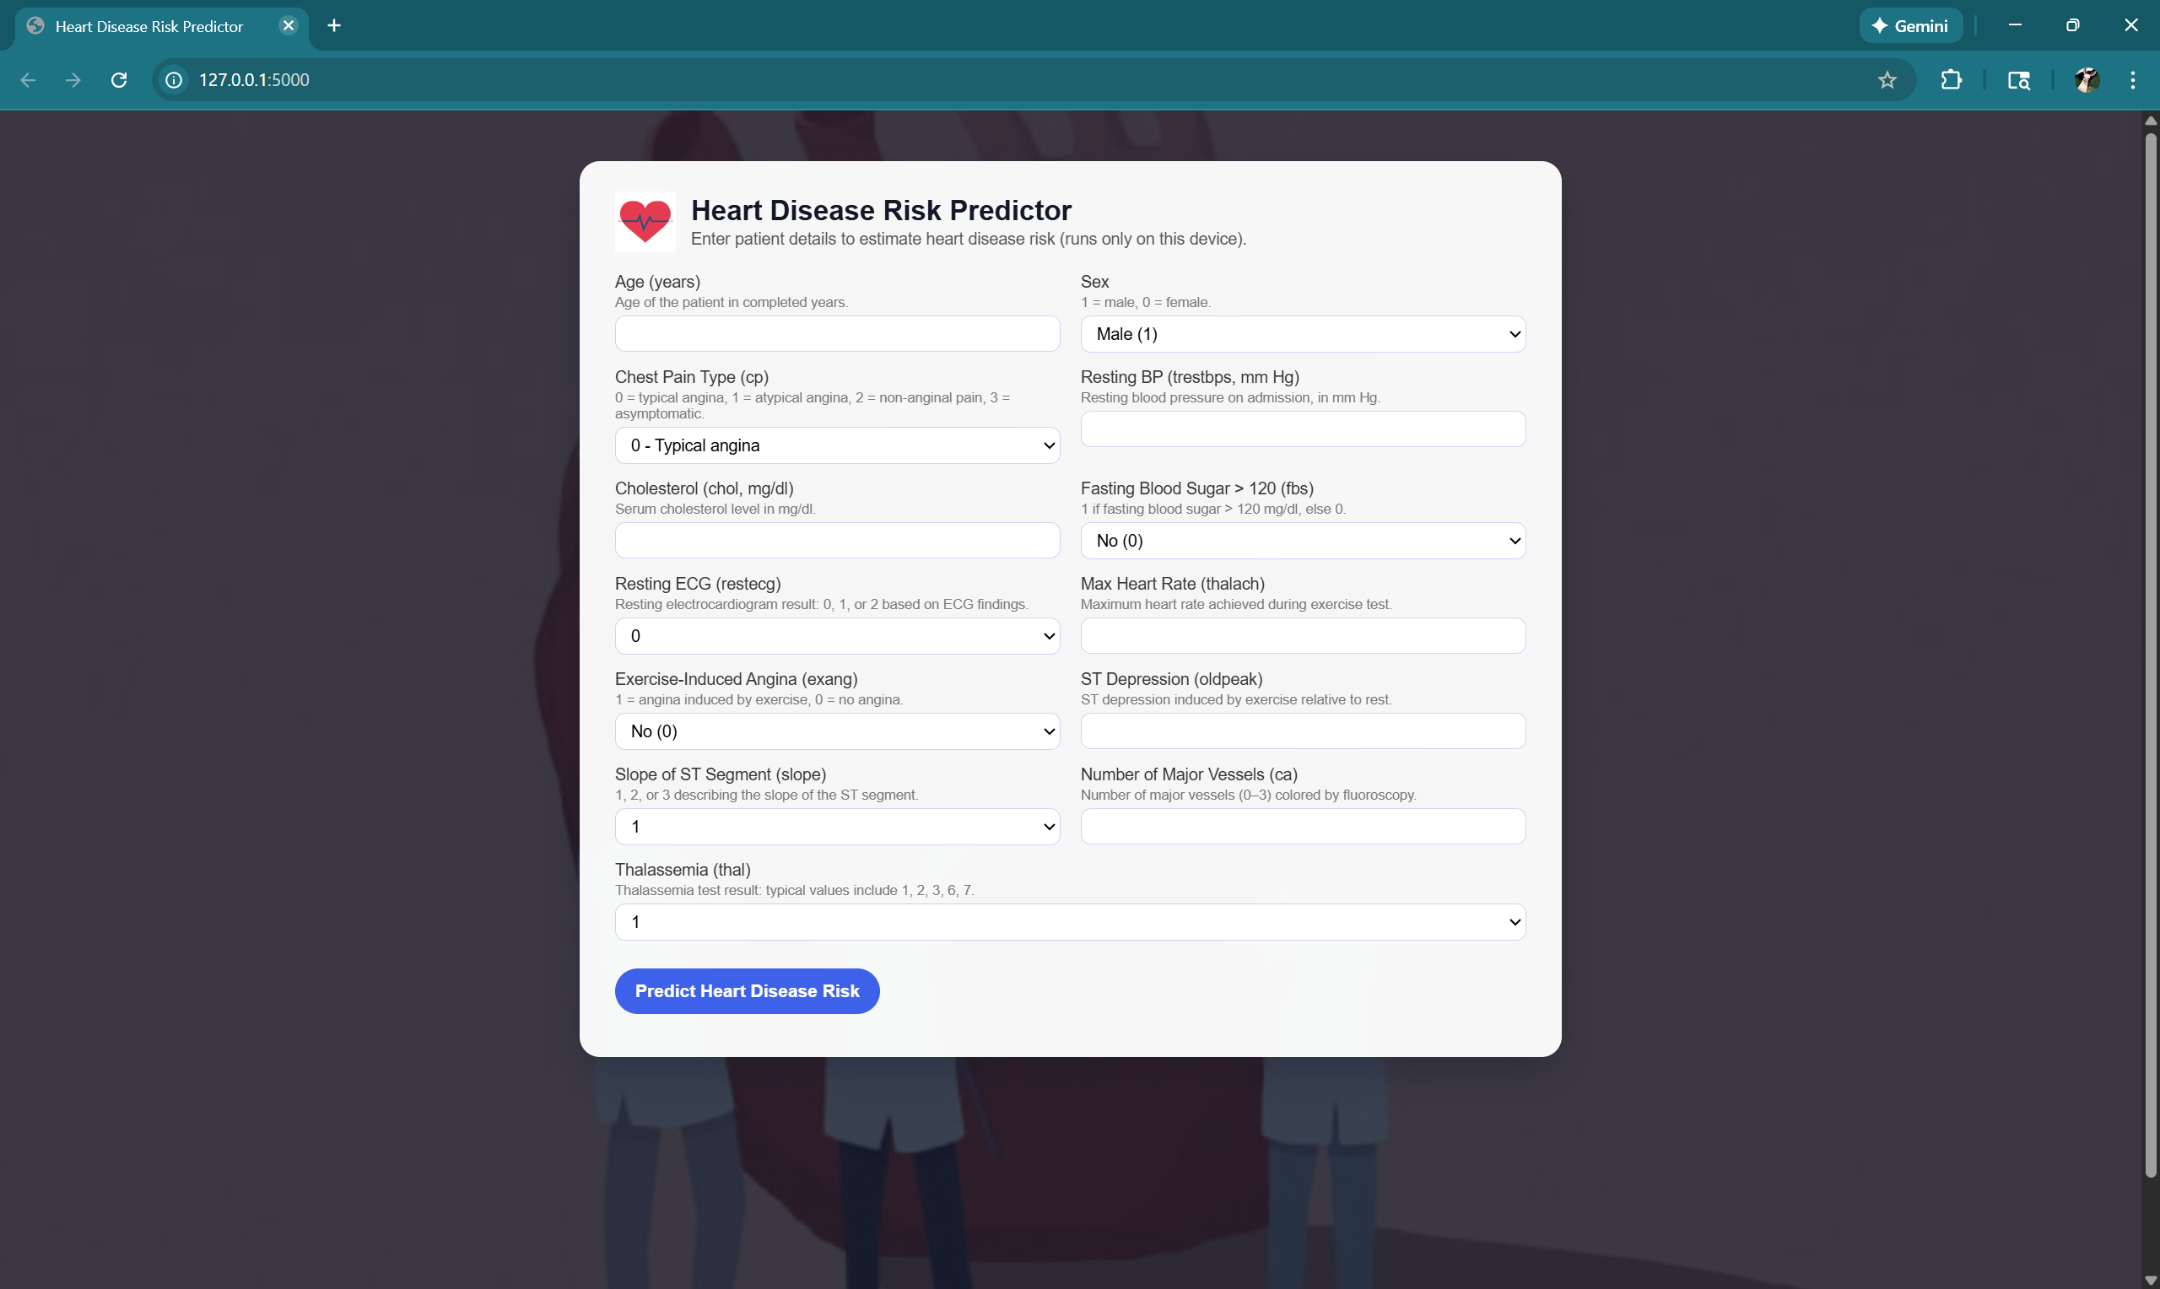

Website overview
Frontend: HTML + CSS
Backend: Flask
Model: Tuned Random Forest (.joblib)
Pipeline: Input → Preprocessing → Prediction → Explanation → Output
Features
Clean UI with background and logo.
13 medical inputs collected via web form.
Real-time prediction using Random Forest.
Displays result images and explanation text
Notes:
--- Handling missing values, removing duplicates, and correcting inconsistencies to ensure data quality. Image source: Microsoft 365 content library

Slide 40
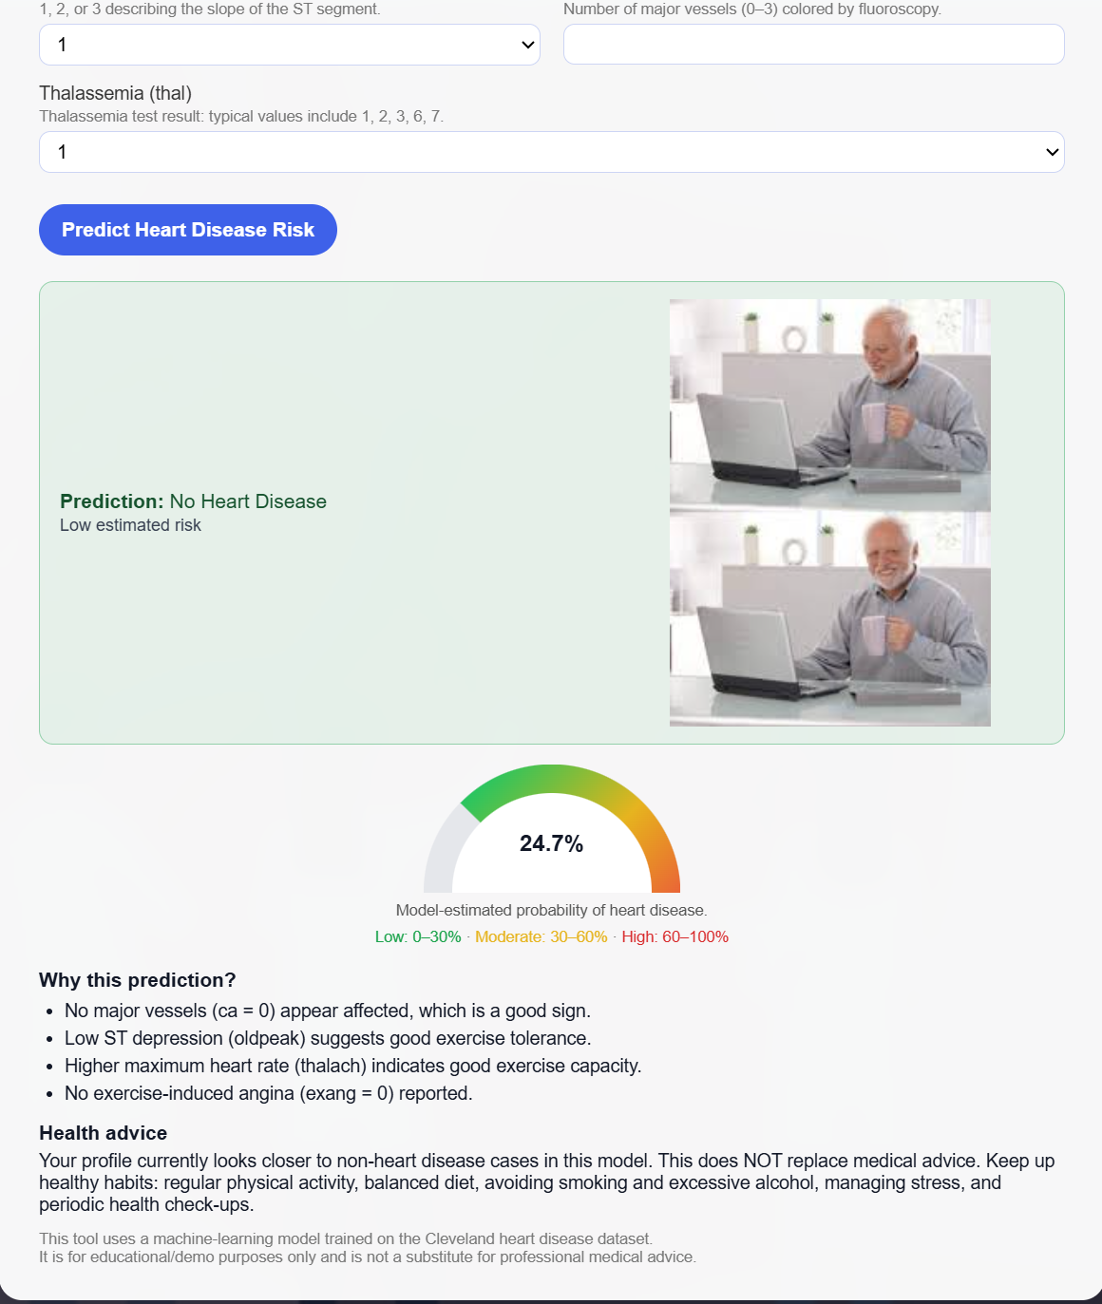
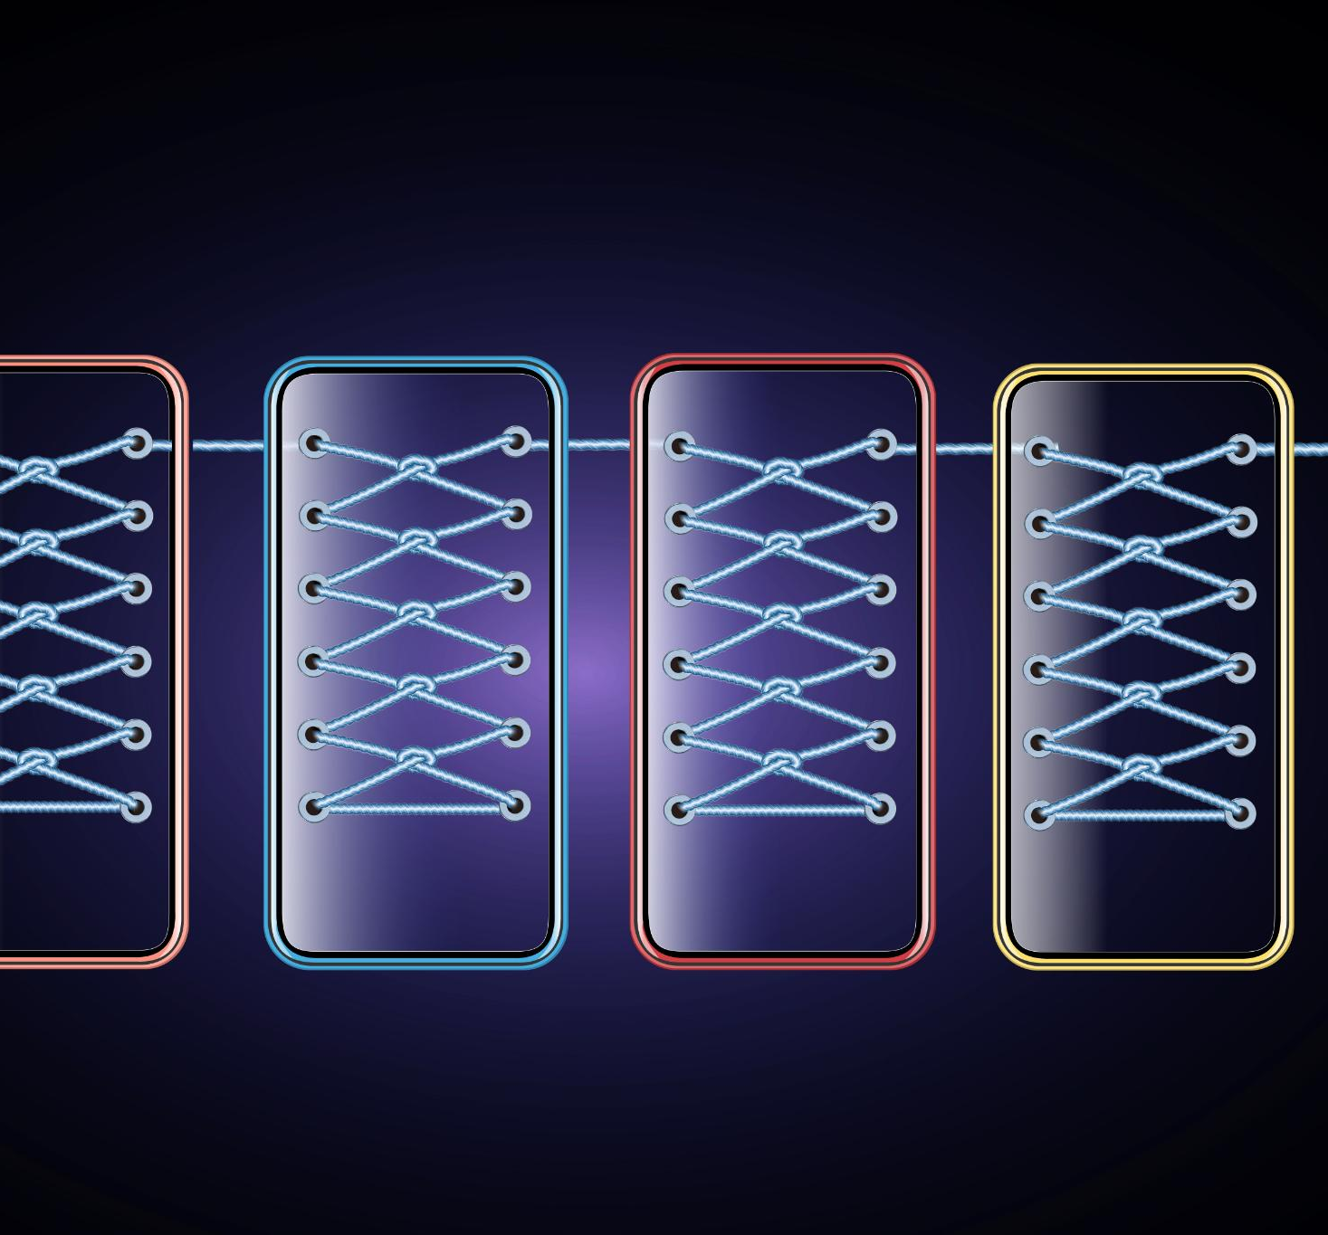
Website Output: Healthy Result
Shows Healthy Image.
Prediction text: “No Heart Disease Detected”.
Motivational message: “Great! Keep maintaining a healthy lifestyle.”
Mini explanation: feature importance contribution.
Notes:
--- Transform categorical variables and normalize numerical features to improve model performance. Image source: Microsoft 365 content library

Slide 41
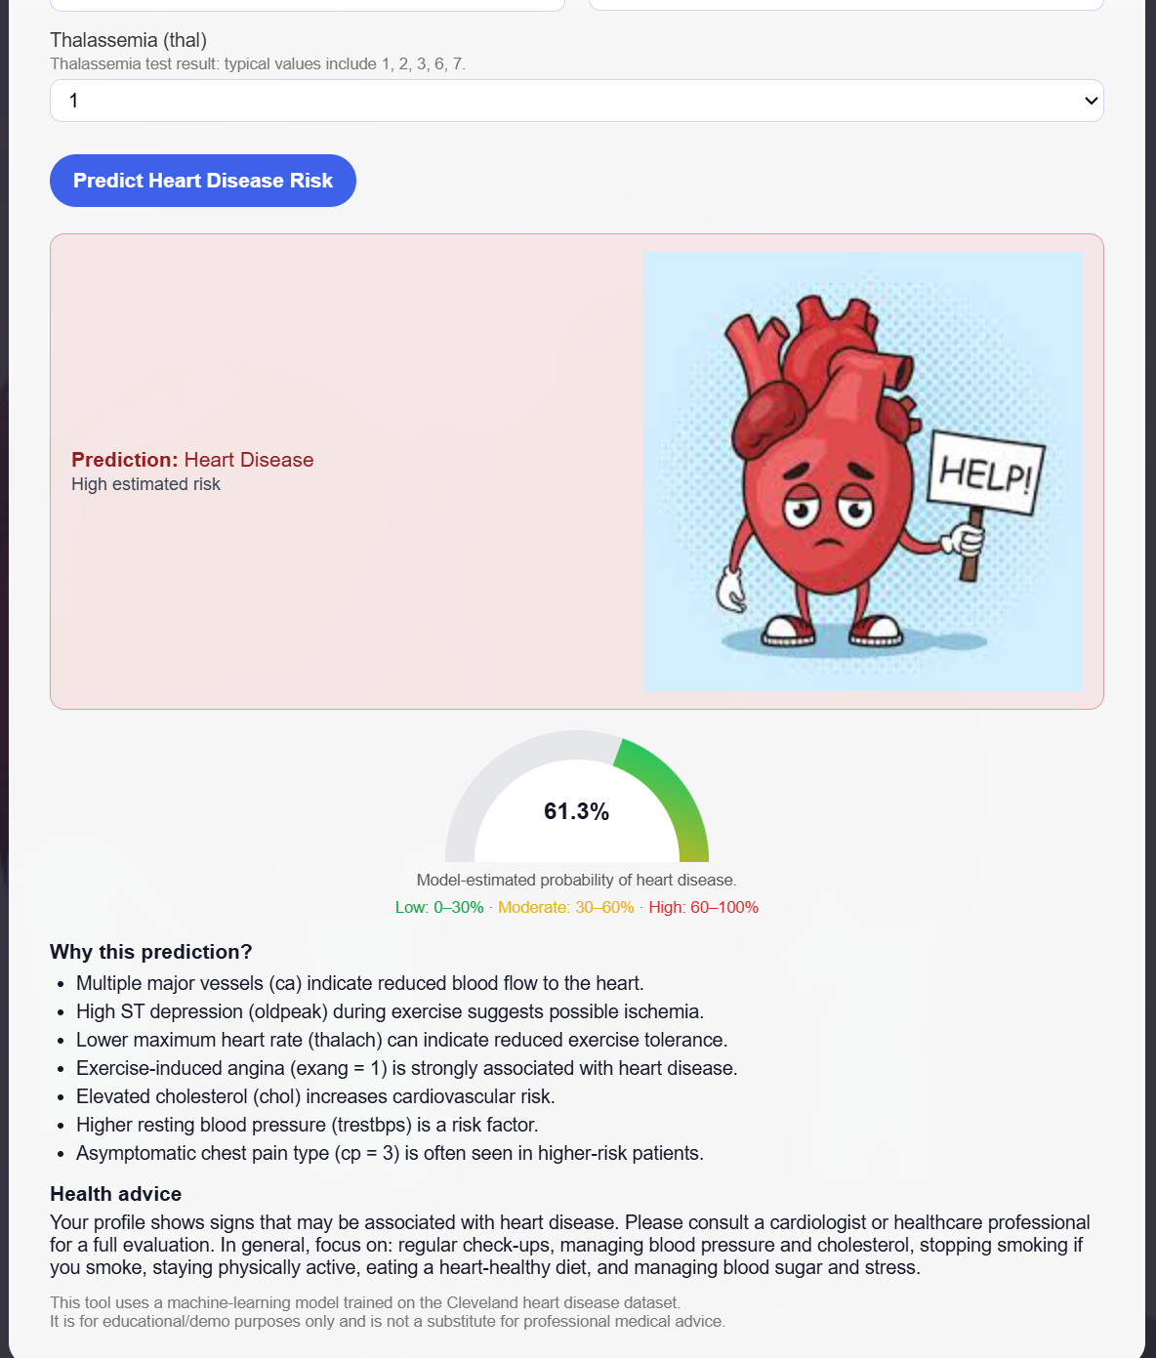

Website Output: Disease Detected
Shows Unhealthy Image.
Prediction text: “Heart Disease Detected”.
Advice: “Model indicates elevated risk. Please consider consulting a cardiologist.”
XAI explanation: oldpeak, chest pain, thalach contributions.
Notes:
--- Apply one-hot encoding to convert categorical features into a numeric format suitable for machine learning algorithms. Image source: Microsoft 365 content library

Slide 42
Conclusion
Summary
Neural Network baseline failed → accuracy 0.47. Initial RF and XGBoost improved performance. Tuned Random Forest achieved 98% accuracy and zero false negatives. Expanded to multiclass classification for more realistic severity assessment. Built full deployment pipeline with website interface and explainability.
Notes:
This project demonstrates that with proper preprocessing and tuning, machine learning models, especially Random Forest, can effectively predict heart disease and potentially support clinical decision making.

